Slide 1
Ping Pong Game
Sprint 1
Group 326
Yuanyuan Dong (ydong1)
Tianyi Chen (tianyic1)

Slide 2
Part I
Background
Part II
PPT模板下载：www.1ppt.com/moban/ 行业PPT模板：www.1ppt.com/hangye/
节日PPT模板：www.1ppt.com/jieri/ PPT素材下载：www.1ppt.com/sucai/
PPT背景图片：www.1ppt.com/beijing/ PPT图表下载：www.1ppt.com/tubiao/
优秀PPT下载：www.1ppt.com/xiazai/ PPT教程： www.1ppt.com/powerpoint/
Word教程： www.1ppt.com/word/ Excel教程：www.1ppt.com/excel/
资料下载：www.1ppt.com/ziliao/ PPT课件下载：www.1ppt.com/kejian/
范文下载：www.1ppt.com/fanwen/ 试卷下载：www.1ppt.com/shiti/
教案下载：www.1ppt.com/jiaoan/ PPT论坛：www.1ppt.cn
Original Goals for Sprint 1
Catalog
Part III
What we have done
Part IV
Problems encountered
Part V
Goals for next sprint

Slide 3
Part I
Part I
Background

Slide 4

Background
Overview of the project
Our project is a web-based online 2-D ping pong game platform which can support multiple users.

Slide 5
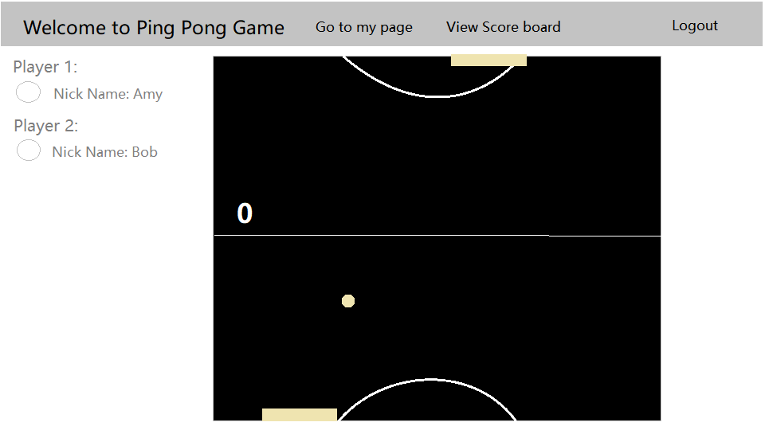
Background

Slide 6
Part II
Part II
Original Goals for Sprint 1

Slide 7
Original Goals for Sprint 1
Building the overall website architecture including user registration, login, verification
Building game coordinating logic, on top of Django channel group

Slide 8
Part III
Part III
What we have done
Built overall website architecture
Built game coordinating logic

Slide 9
What we have done
Demonstration
Built overall website architecture
HTMLs, link in pages
Built game coordinating logic
User can create game room, randomly join a game or join by id
Only two user can join same room at same time
Now two users randomly generate a winner

Slide 10
What we have done
Player 1
Socket 1
Socket 2
Game Server
Player2
Player3
Socket 3

Slide 11
What we have done
Player 1
Server
Player 2
Player 1
Server
Player 2
connect
connect
connect
connect
ready
ready
ready
ready
Game score
disconnect
unready
Game score
winner
winner

Slide 12
Part IV
Part IV
Problems encountered
Implementation of channels

Slide 13
Problems encountered
Problem: The logic to coordinate the game is hard to design with stateless channel.
Solution:
server side use model to store the state (later we need to use cache like Redis to enhance throughput).
communication: message use TYPE to indicate the message type.

Slide 14
Part V
Part V
Goals for next sprint
Implement Game logic
Refine game logic

Slide 15
Goals for next sprint
Implement Game logic
player controls a bar to bounce the ball to opposite player
the user lose 3 points first will lose the game

Slide 16
Thank you!

